Slide 1

Panoptic FPN
Presented By:
Audun Wigum Arbo, Even Dalen, Christian Echtermeyer

Slide 2

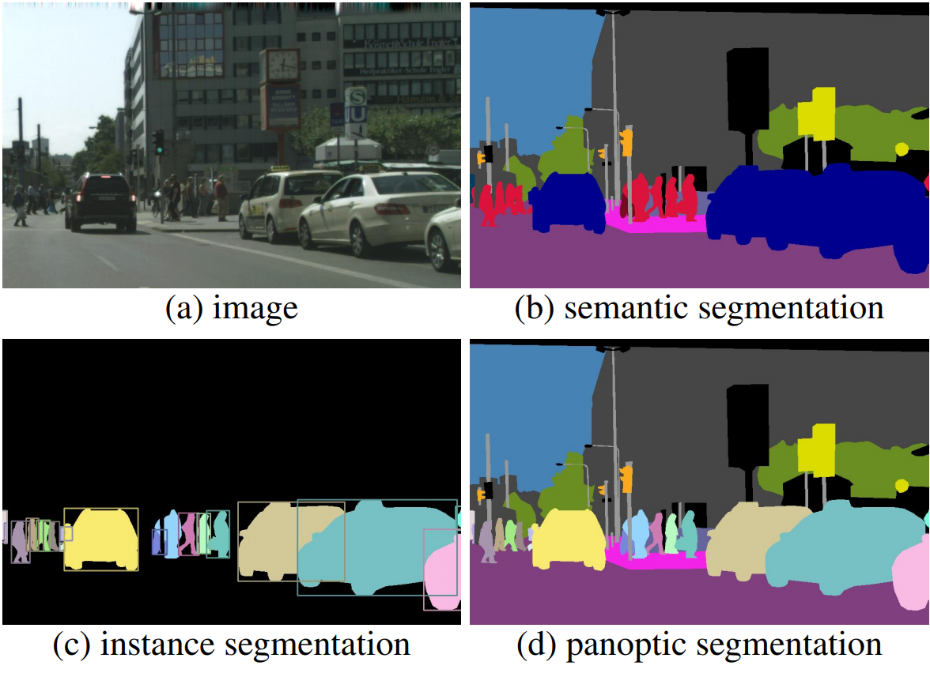
What is panoptic segmentation?
“including everything visible in one view”
Notes:
Panoptic = semantic + instance segmentation
The task format we adopt for panoptic segmentation is simple: each pixel of an image must be assigned a semantic label and an instance id. Pixels with the same label and id belong to the same object; for stuff labels the instance id is ignored.

Slide 3
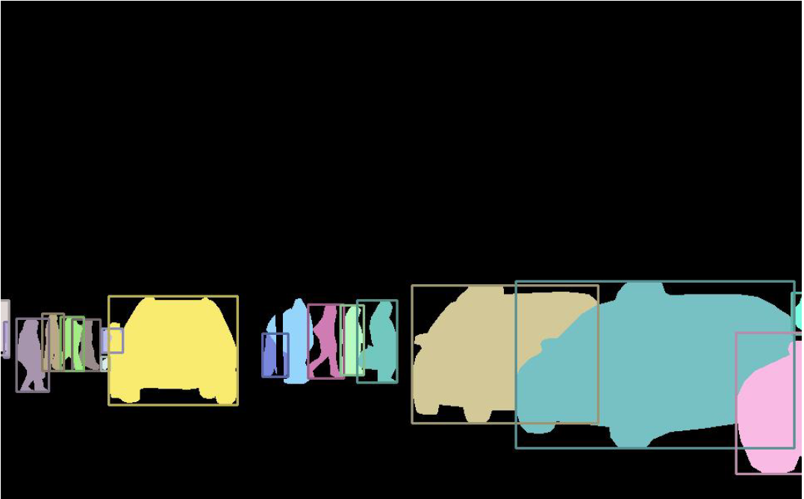
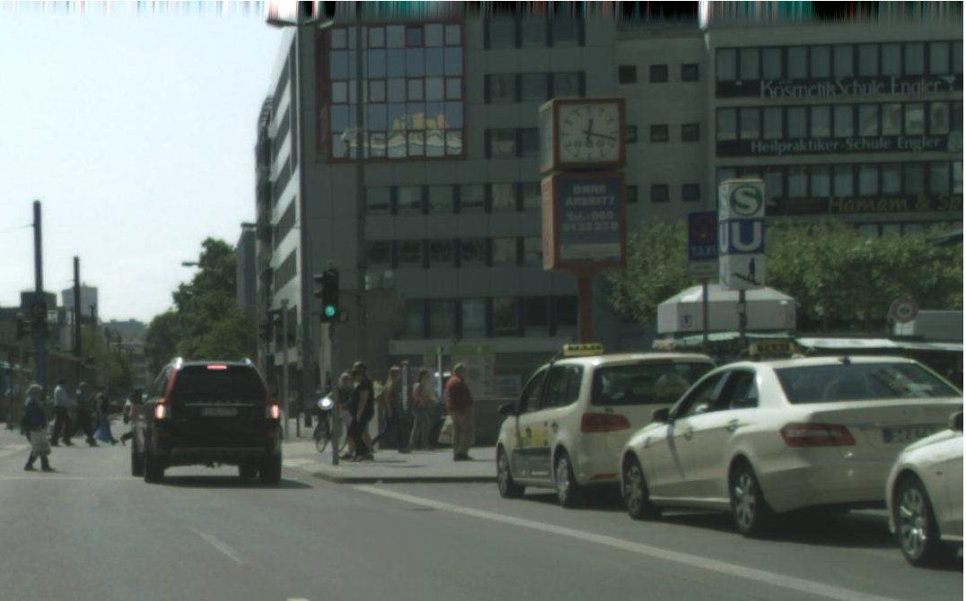
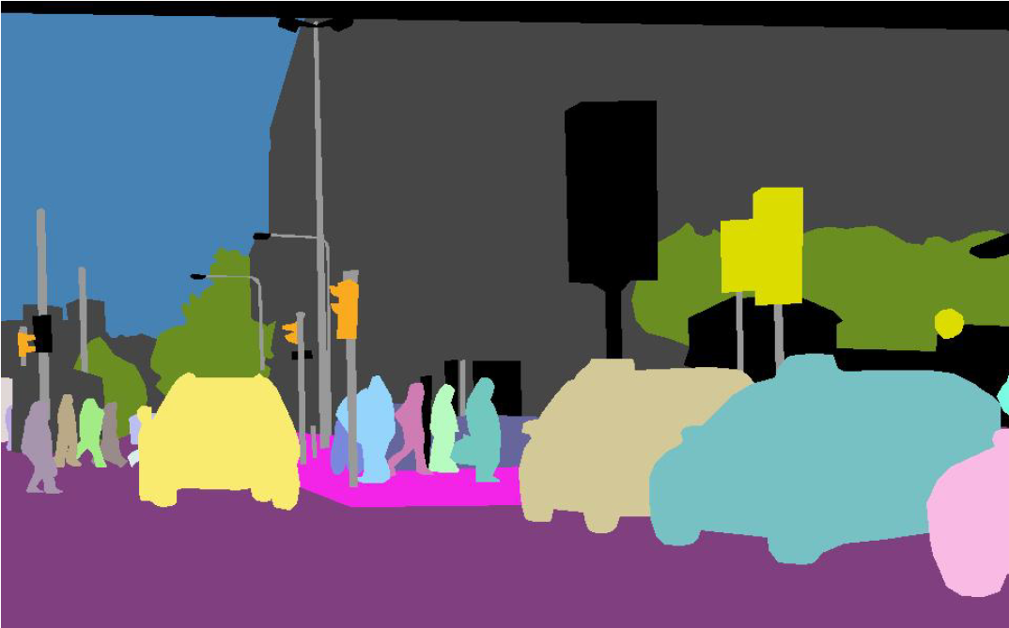
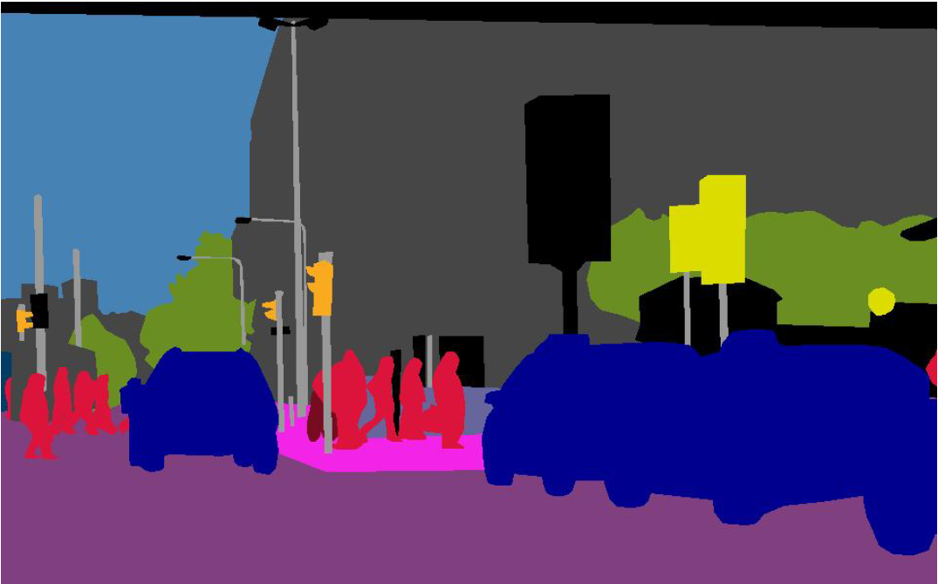
Every object has an identity
Every object has a class AND an identity
Every object has a class

Slide 4

Panoptic Segmentation Metric
"...existing metrics are specialized for either semantic or instance segmentation and cannot be used to evaluate the joint task involving both..."

Slide 5

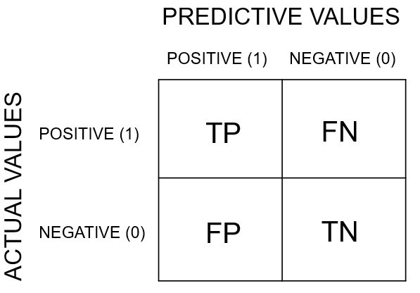
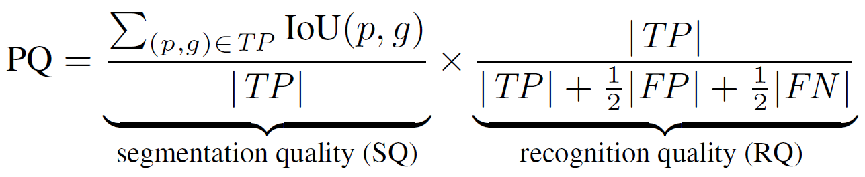
IoU > 0.5 = Match
p = predicted segment
g = ground truth segment

Slide 6
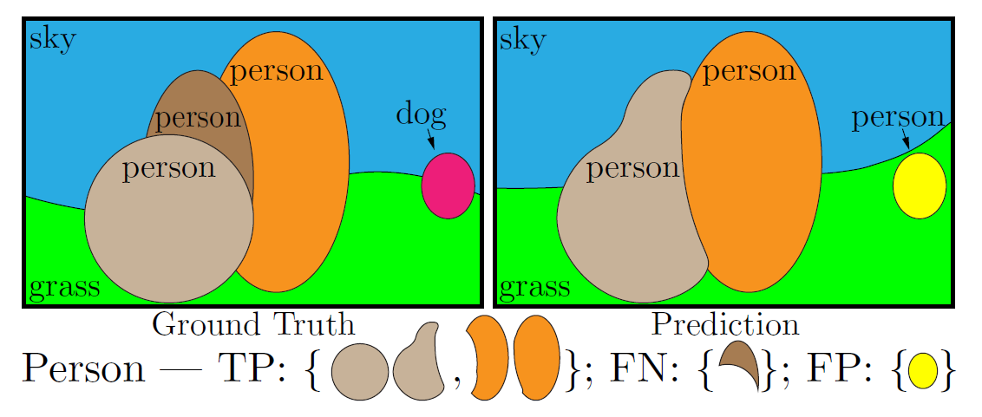

Slide 7
Contribution of Panoptic FPN
Previous approaches used separate networks:
One for instance segmentation
One for semantic segmentation.
Panoptic FPN uses a single network.
Increased efficiency and memory footprint.
Established a baseline performance for future work.

Slide 8
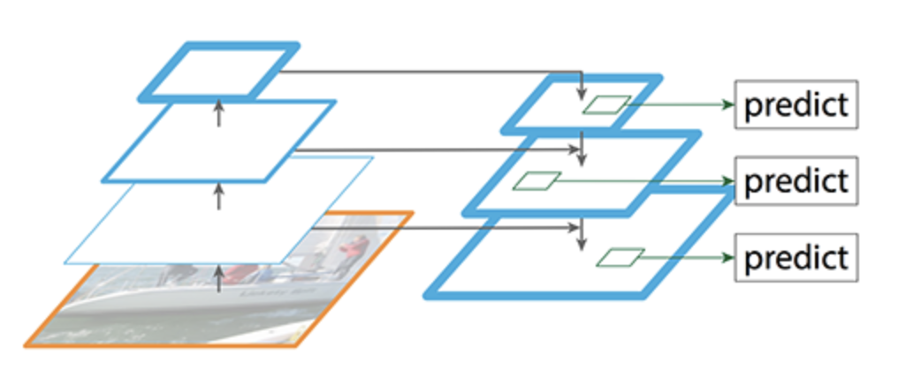
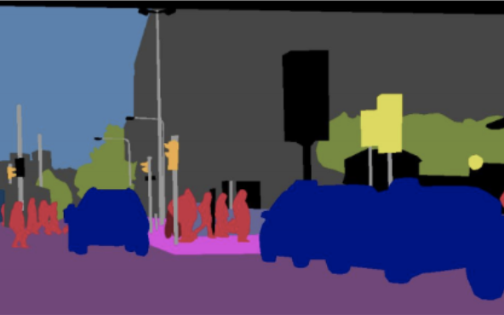
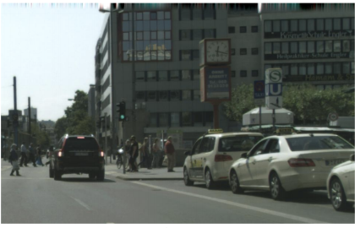
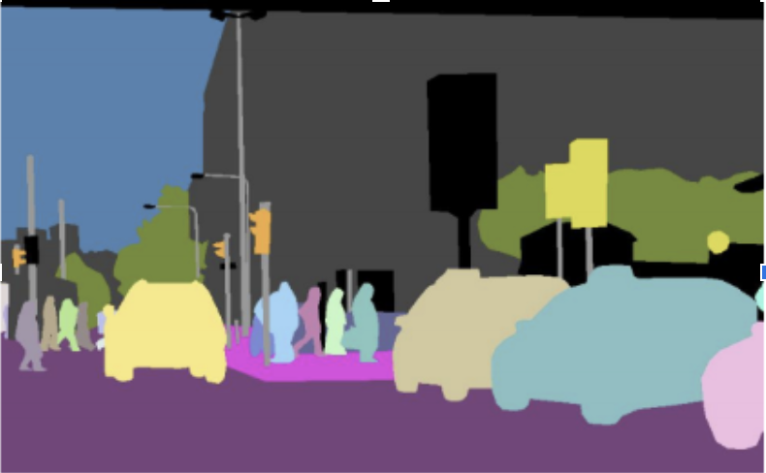
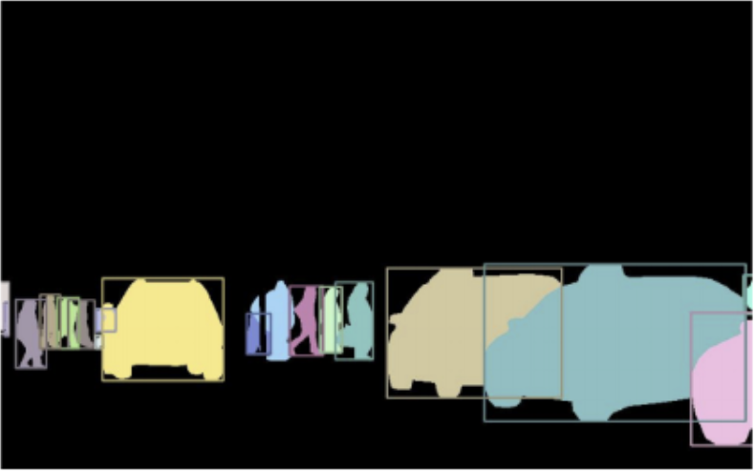
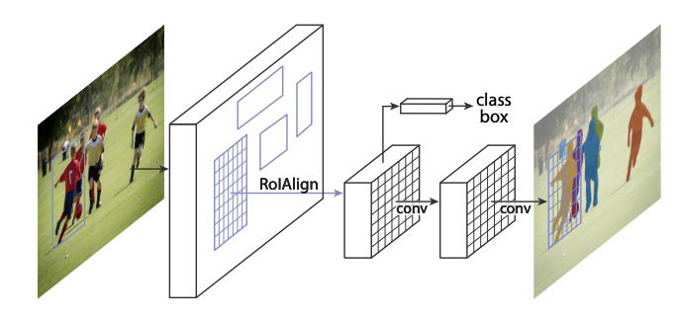
Inefficient approach: Semantic + instance = Panoptic
FPN
Semantic segmentation
Input
Panoptic segmentation
Mask R-CNN
Instance segmentation
Notes:
Previous state of the art solution first did semantic segmentation by sending the entire input into a Feature Pyramid Network.
Then they took the input and sent it into a network very good at instance segmentation, for instance Mask R-CNN.
Then they combined the result of each individual network, and got the panoptic segmentation.

Slide 9
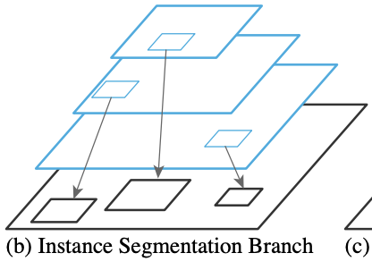
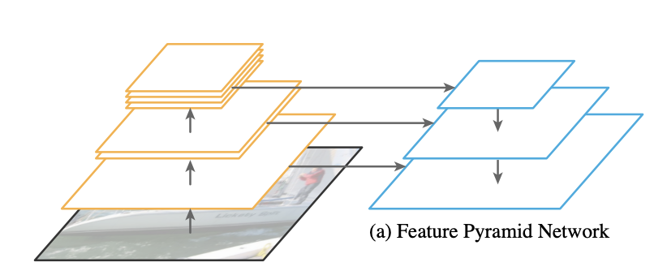
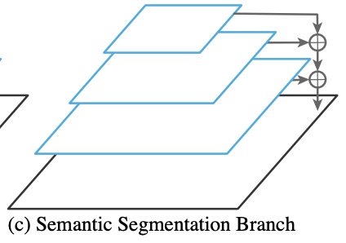
Panoptic FPN architecture
Based on Mask R-CNN head
Shared FPN backbone
Scale and sum feature maps.
Notes:
FPN attempts to combine the two networks into a single network, and sharing as much computations as possible between the networks.
Process:
1. Generate feature maps using FPN in different spatial resolutions.
2. Use the feature maps with the established Mask R-CNN head to generate instance segmentation.
3. Scale the feature maps independently to the same size. Then sum the feature maps to generate semantic segmentation.

Slide 10
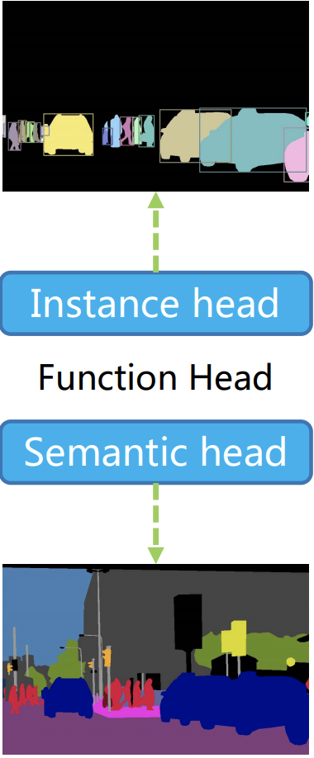
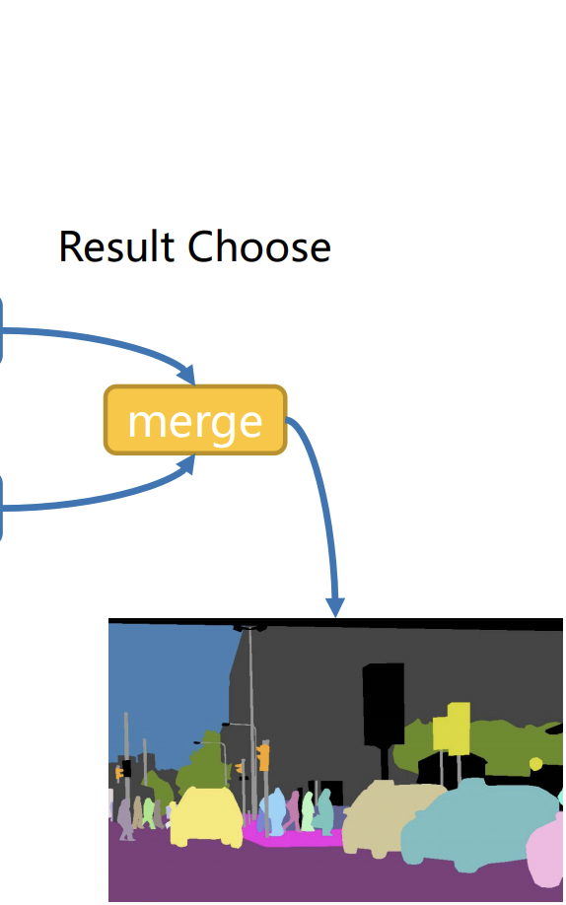
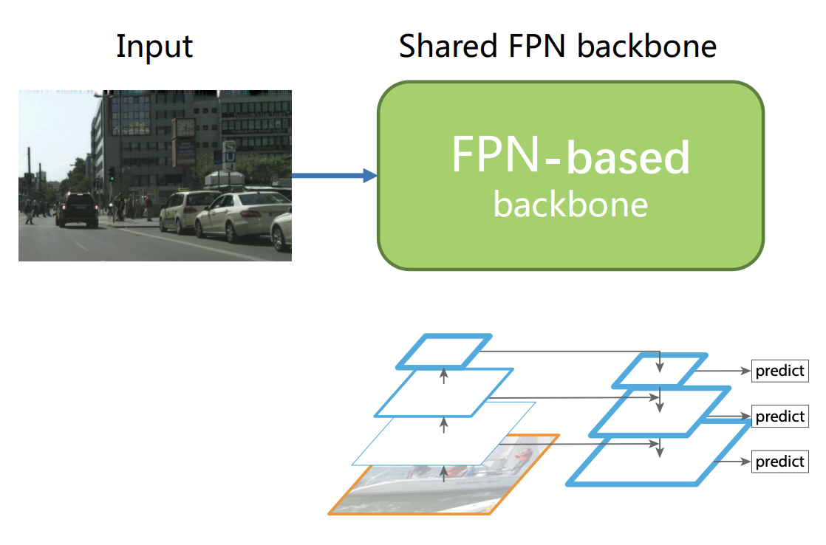

Source: http://presentations.cocodataset.org/ECCV18/COCO18-Panoptic-Caribbean.pdf
Notes:
Example of Panpotic FPN using images.

Slide 11

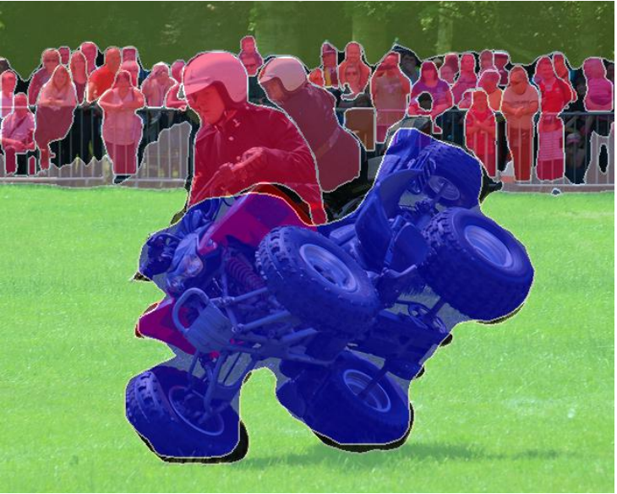
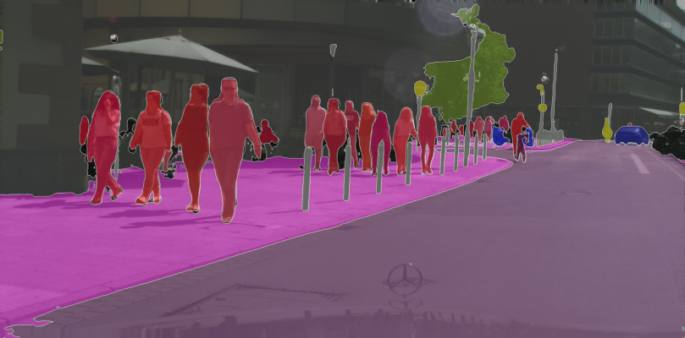
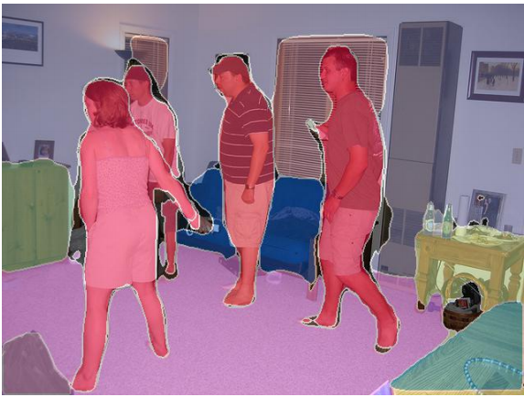
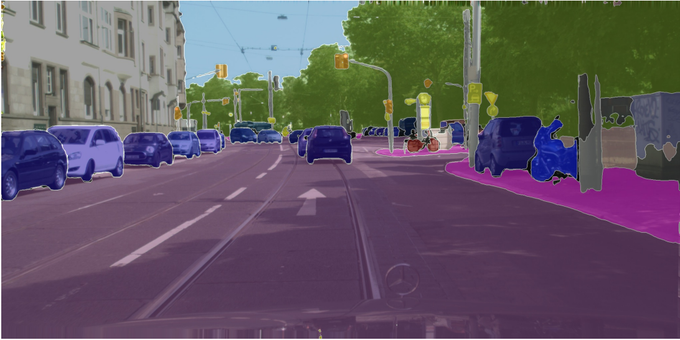
Results: some example output

Slide 12

Results: the metric values
Loss: λ_{s}Loss_{S}+λ_{i}Loss_{i} Scaling of the individual losses:
Semantic seg. loss with λ_{s}
Instance seg. loss with λ_{i}
The following results use the optimal λ_{s} and λ_{i} from the set {0.5, 0.75, 1.0}

Slide 13
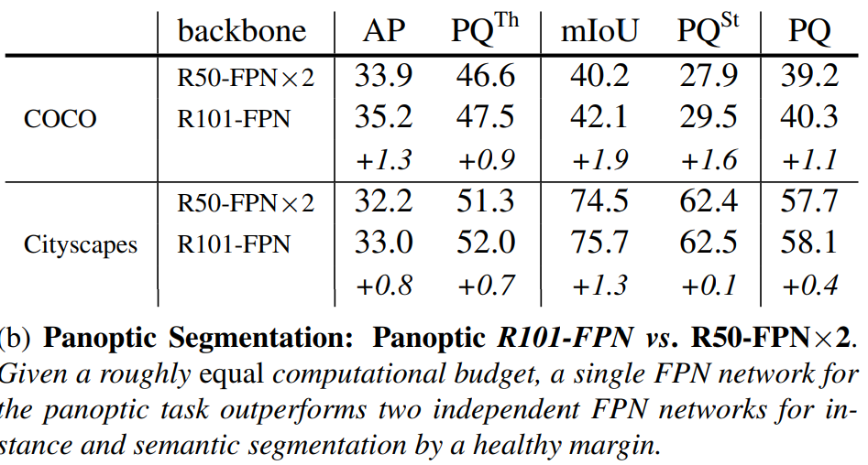
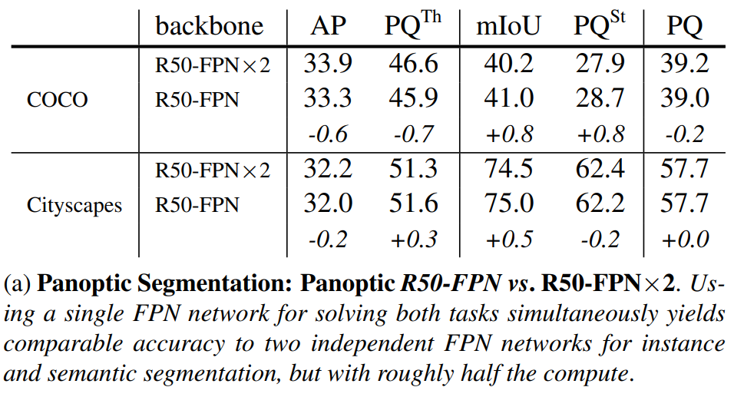
Results: Two FPN networks VS combined

Slide 14
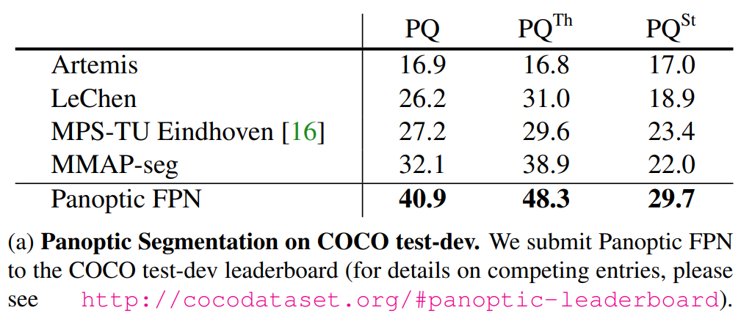
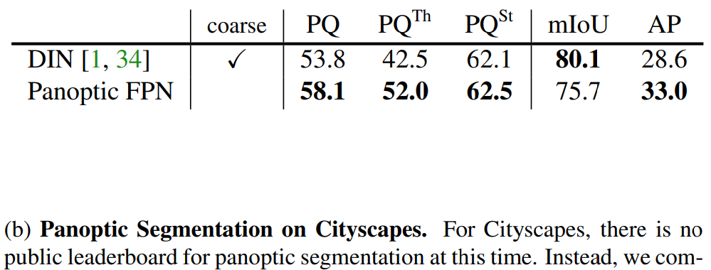
Results: COCO + Cityscapes panoptic (as of 2018)*
*Single-network entries only

Slide 15
Summarized: Main contributions of Panoptic FPN
A single network:
A common Feature Pyramid Network (FPN)
Mask R-CNN (instance segmentation) + branch with semantic segmentation
State-of-the-art performance in both instance- and semantic segmentation, with only ~0.5x computing resources compared to multi-network
Outperforms all single-model entries in the 2018 COCO Panoptic Segmentation Challenge
A good baseline for the panoptic segmentation task

Slide 16
References
Panoptic Feature Pyramid Networks
CVPR 2019 Oral Session 2-2A: Recognition
Feature Pyramid Networks for Object Detection
Panoptic Segmentation

